Slide 1
A short introduction to the Israeli-Palestinian conflict

Slide 2
What are we talking about?
Palestine – biblical times
Israel and Palestine today
Diercke Weltatlas: Palästina zur Zeit Jesu
https://www.bbc.com/news/newsbeat-44124396

Slide 3
The Zionist Movement
Zion – What does that mean?
Zionism
Zionism, Jewish nationalist movement that has had as its goal the creation and support of a Jewish national state in Palestine, the ancient homeland of the Jews. Though Zionism originated in eastern and central Europe in the latter part of the 19th century, it is in many ways a continuation of the ancient attachment of the Jews and of the Jewish religion to the historical region of Palestine.
https://www.britannica.com/topic/Zionism
Zionskirche Bethel (“Zion“ in Christian tradition = heaven)
Cambridge dictionary:
the hill on which the city of Jerusalem was originally built, sometimes used to refer to the city itself

Slide 4
British Mandate
https://www.britannica.com/place/Palestine/World-War-I-and-after

Slide 5
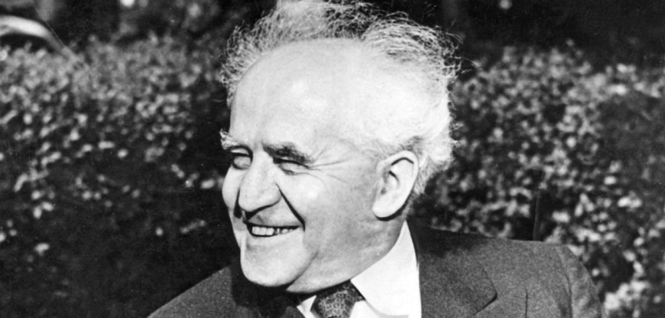
Israel
The United Nations partitioned Palestine, allocating about half the land to the Palestinian Arabs and about half to the Jews to create the new state of Israel.
On May 14, 1948, in Tel Aviv, Jewish Agency Chairman David Ben-Gurion proclaims the State of Israel, establishing the first Jewish state in 2,000 years. Ben-Gurion became Israel’s first premier.
The Arab nations surrounding Israel immediately invaded with the intent of crushing the new state. Israel, however, captured additional territory during the war.
https://kids.britannica.com/students/article/Palestine/276254,
https://www.history.com/this-day-in-history/state-of-israel-proclaimed
Bild: https://www.welt.de/geschichte/kopf-des-tages/article238742671/David-Ben-Gurion-Der-Zweckpessimist-der-Israel-gruendete.html

Slide 6
Palestine
The experience of exile (as many Palestinans had to flee) shaped Palestinian political and cultural activity - ultimately, a movement seeking to reclaim Palestine and end the existence of the Jewish state developed.
An umbrella organization of several Palestinian groups, the Palestine Liberation Organization (PLO), was founded in 1964 and thereafter claimed to be the sole representative of the Palestinians. Its most famous member was Yasser Arafat.
https://kids.britannica.com/students/article/Palestine/276254
Bild: https://www.britannica.com/biography/Yasser-Arafat

Slide 7
Conflict
PLO launched frequent guerrilla attacks against Israel from across its borders. Terrorism became a key element in the Palestinian struggle against Israel.
Six-Day War (1967): Israel occupied East Jerusalem, the West Bank, Gaza Strip, and Golan Heights and established military administrations in those regions.

Slide 8
Conflict
Settlement: Beginning in the late 1970s, increasing numbers of Israelis settled in the occupied areas, a policy which outraged the Palestinians.
Intifadah: Widespread anti-Israeli rioting erupted in the occupied territories in 1987. Hamas, a Palestinian Islamic movement dedicated to the destruction of Israel, was formed at the beginning of this uprising.
http://news.bbc.co.uk/2/shared/spl/hi/middle_east/03/v3_israel_palestinians/maps/html/settlements_checkpoints.stm

Slide 9
Peace?
https://www.nobelpeaceprize.org/laureates/1994

Slide 10
Conflict and Peace, II
Second Intifadah (from 2000 on): characterized by an escalating cycle of Palestinian suicide bombings targeting Israeli citizens followed by swift and severe Israeli reprisals. Israeli troops reoccupied the West Bank and Gaza Strip and at times prevented Palestinians from leaving the occupied zones.
Peace process, II: The United States, the European Union, Russia, and the United Nations then formally introduced their “road map” to peace, a plan that called for a Palestinian state to be established by 2005. The plan was accepted, but its implementation was delayed.
https://kids.britannica.com/students/article/Palestine/276254

Slide 11
inner-Palestinian conflicts
Fatah
Hamas
https://de.wikipedia.org/wiki/Fatah
https://de.wikipedia.org/wiki/Hamas

Slide 12
today
Tensions between Israel and Palestine have increased during 2023. The violence has fuelled speculation that another ‘intifada’ could be imminent.
https://lordslibrary.parliament.uk/israel-palestine-conflict-recent-developments-and-statements/
April 2023, Berlin: many people showed up in the Kreuzberg and Neukölln neighborhoods at a demonstration organized in response to the police clashes with Muslim worshipers at the Temple Mount and Al-Aqsa Mosque in Jerusalem. The police are investigating the fact that people chanted “Death to the Jews” and “Death to Israel,” phrases that if verified could be criminal offenses under Germany’s strict post-World War II hate speech laws. https://www.timesofisrael.com/death-to-the-jews-chants-heard-at-berlin-pro-palestinian-rally/ and https://www.rbb24.de/politik/beitrag/2023/04/berlin-demo-palaestinenser-empoerung.html

Slide 13
Questions?
What do you wish for the future?
How does the conflict affect your daily life?
Do you know people living in Gaza?
???
https://www.semanticscholar.org/paper/Zababdeh%3A-A-Palestinian-Water-History-Templin/673a171d6c75c28246bdabce0ca634a866b8fe3b

