Slide 1
Enhance Self-esteem
Lily, Marina, Sara, Amaya

Slide 2
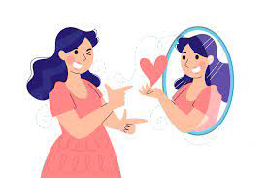
Definition
Self-esteem is how we value and perceive ourselves. It´s based on our opinions and beliefs about ourselves.
Self-esteem is important because it heavily influences people‘s choices and decisions by making it more or less likely that people will take care of themselves and explore their full potential.
Self-esteem is influenced by a lot of factors, like life experiences, quality of life, age and health.

Slide 3
Major self-esteem drops during Adolescence
1st drop at ages 9-13
Loss of childhood
Certain behaviors are considered childish
Sacrificing cherished toys or hobbies
2nd drop at ages 18-23
Independence expected
Overwhelming
Disappointed in themselves
After Carl E. Pickhardt Ph.D

Slide 4
Who do I want to be?
A 2015 German HSBC-Study shows that teenagers:
think they are to fat
25.6% Boys
42.3% Girls
have eating disorders
21.8% Girls
11.9% Boys

Slide 5
Bean bags game
On Tuesday we played a game where we had to throw a bean bag to get points while being motivated/demotivated.
How did you feel with the different coaches?
How did you perform with the different coaches?

Slide 6
How to improve your self-esteem
Use positive affirmations (ex. „I can do this“)
Keep a self-esteem journal (every day write the good things that happened that day)
Set a realistic goal and try to reach it (show yourself you can reach them)
Exercise
Practise mindfulness (not worrying about the past and the future encrease self-esteem)

Slide 7
How to improve your self-esteem
Identify what you`re good at
What are you good at?
Be kind to yourself
Don‘t always say yes
Build positive relationships
Accept compliments
Social media detox

Slide 8
A sun of compliments
Draw a sun on paper, exchange them and write two compliments to the people in your group, thank the others, then reflect on these questions:
Do you like receiving compliments from others?
Which compliment describes you best?
Do you usually compliment other people?

Slide 9
Why you should give compliments
Compliments:
increase your happiness
make you grateful
make your interpersonal relationships stronger
increase your stress resilience and physical health

Slide 10
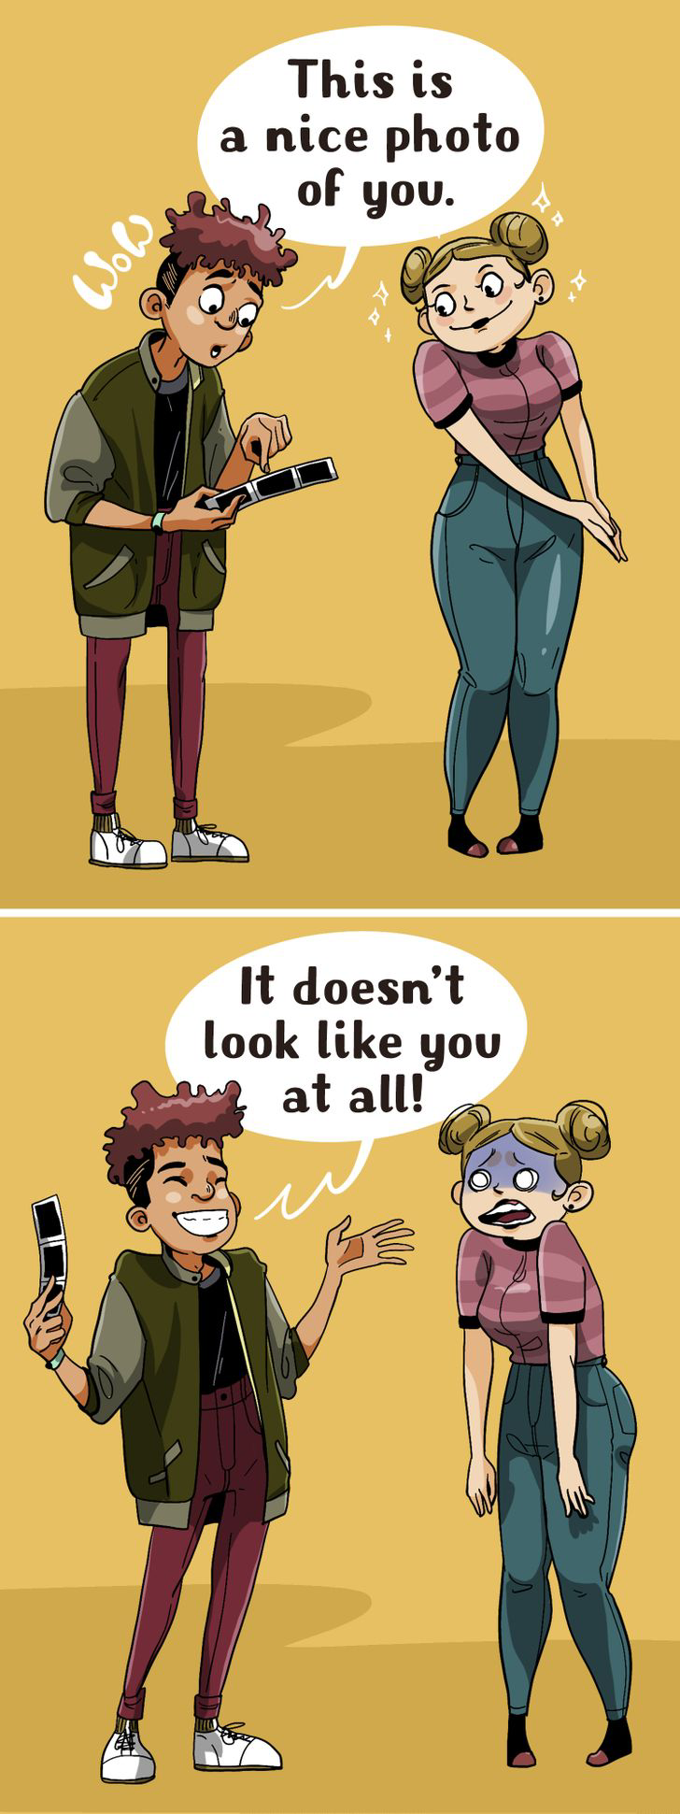
Compliments you shouldn’t give
“Wow! You have lost so much weight!“
“You‘re so tall!“
“You look good today.“
“You‘re so cool.“
“You‘re really intelligent for a woman.“
“You look like someone who knows how to have fun.“

Slide 11
Thank you for listening
Do you think you`ll use some of our tips?

